Slide 1
Summarising data
Task A: Calculating all of the averages
1) Complete the information showing the mean, median, and mode for the following datasets.
a)
1 | 1 | 1 | 3 | 7 | 10
mean | 3.83 | median | 2 | mode | 1
b)
14 | 23 | 24 | 25 | 27 | 27 | 28
mean | 24 | median | 25 | mode | 27
b)
2.5 | 3.5 | 4 | 5.5 | 7 | 7 | 8.5 | 8.5
mean | 5.81 | median | 6.25 | mode | bimodal at 7 and 8.5
2) Calculate the mean, median, and mode of these three datasets.
a)
2.5 | 2.5 | 4 | 9 | 10.5
mean | 5.7 | median | 4 | mode | 2.5
b)
15 | 18 | 20 | 20 | 23 | 24
mean | 20 | median | 20 | mode | 20
b)
4 | 4 | 4 | 5 | 7 | 7 | 7 | 8 | 8
mean | 6 | median | 7 | mode | bimodal at 4, 7
3) For question 2, which of the datasets was the odd one out? Justify your answer.
There are many possible responses, including:
b is the only dataset where the mean, median, and mode are all the same. c is the only dataset where the mode is bimodal. a is the only dataset where the mean and mode are decimals.

Slide 2
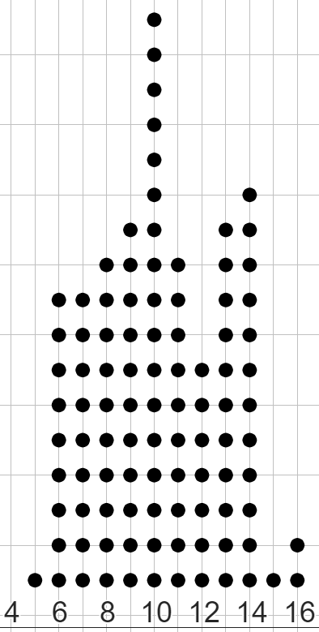
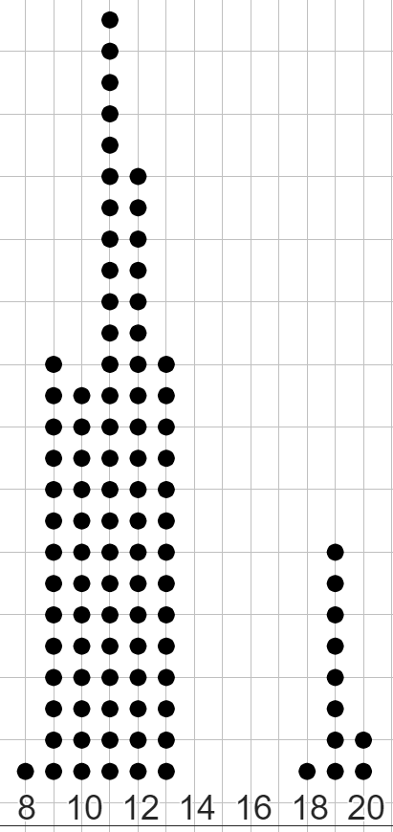
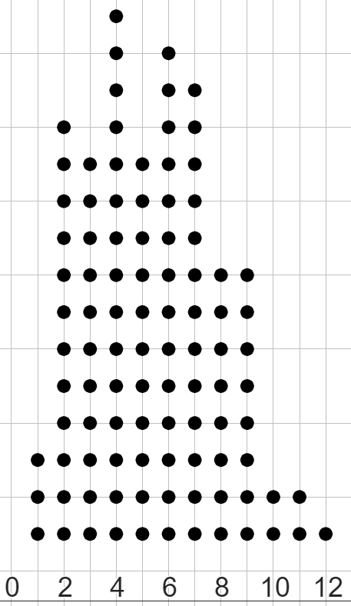

Summarising data
Task B: Dealing with an unrepresentative mean
1) Match the mean to each dataset.
mean = −3
a)
2 | 2 | 2 | 4 | 6 | 7 | 7 | 9 | 15
b)
−4 | −3 | −3 | −3 | −1 | 2 | 3 | 3 | 6
mean = 0
c)
6 | 7 | 7 | 8 | 10 | 10 | 32 | 32
mean = 6
mean = 14
2)
a) Calculate the mean of this dataset.
b) Explain whether the mean is a representative summary of the dataset or not.
11 | 11 | 11 | 49 | 51 | 51 | 51 | 51 | 51 | 53
mean = 39
No, as 39 is neither near the centre of the dataset, nor is it close to any data points.
a)
b)
c)
3) Match the mean to each dot plot.
c)
mean = 5.3
a)
mean = 10.2
b)
mean = 11.9
mean = 17.1

Slide 3
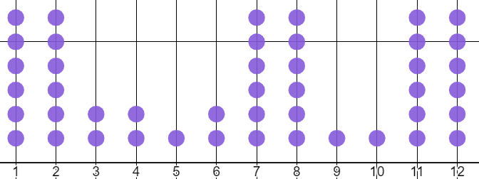
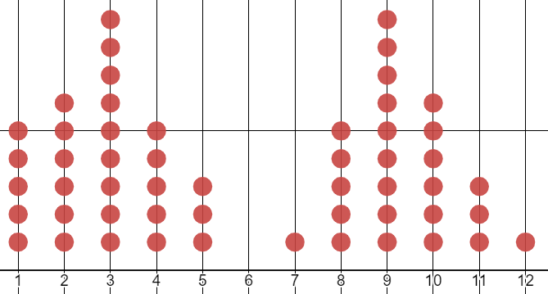
Summarising data
Task C: Dealing with an unrepresentative median or mode
1) For which one of these datasets is the median the more representative summary, and for which one is the mode the more representative summary?
You must write one sentence why you chose that one over the other.
median = 7
median = 6
The median is more representative. This is because there is no mode.
The mode is more representative. This is because the median is not near any high-frequency values.
2) Answer parts a, b, and c for both these datasets.
dataset 1
1 | 2 | 3 | 3 | 3 | 3 | 3 | 3 | 3 | 3 | 4 | 6 | 9 | 57
dataset 2
2 | 2 | 2 | 3 | 4 | 4 | 4 | 5 | 5 | 6 | 6 | 6 | 8
a) Calculate the mean, median, and mode for this dataset.
b) Which averages do you think are the most representative summaries of this dataset?
c) What benefit might there be to still using the average that is least representative?
Dataset 1
a) mean ≈ 7.4 median = 3 mode = 3
b) The median and mode are the most representative summaries. This is because they are both similar in value. 3 is by far the most frequent value, and is also the value in the middle of the data.
c)The mean may still be useful because it shows how unbalanced the data points are. If all the values of the data points were added together and evenly distributed, then the value of many data points would change a lot.
Mathematics in Education and Industry.

